Slide 1
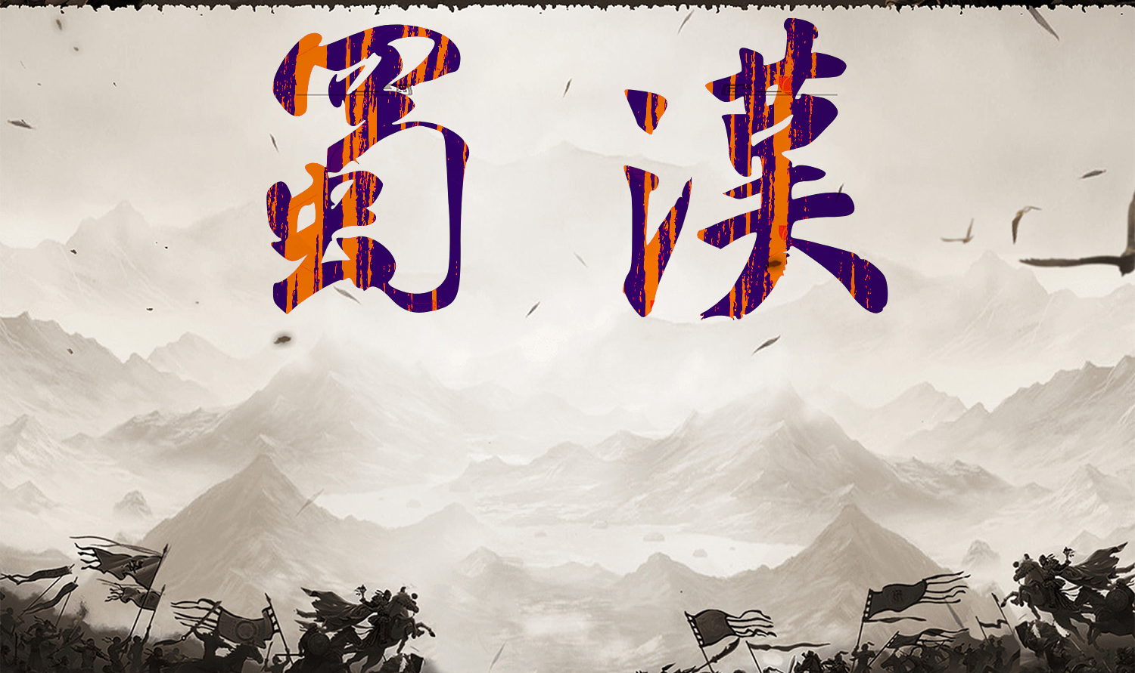
theme:
group members: 王鸣一，孙溯阳，李璟昊，张喆，张耘丰
reporting time：October 31st

Slide 2
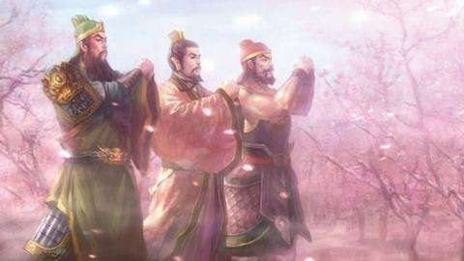
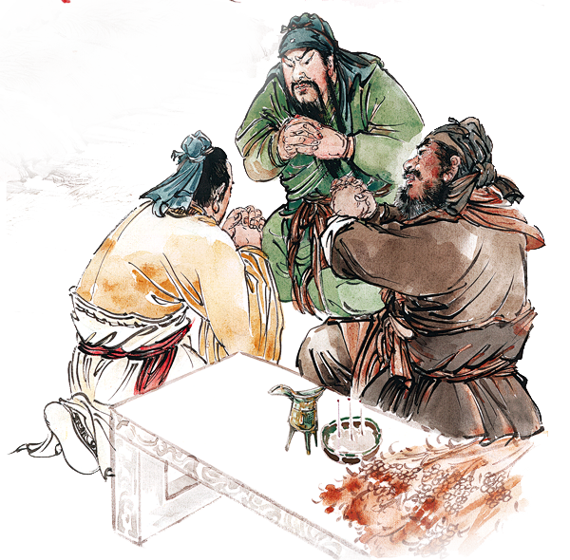
Performance:three mariage in peachs 桃园三结义
Not to be born on the same day, but to die on the same day
不求同年同月同日生，单愿同年同月同日死

Slide 3
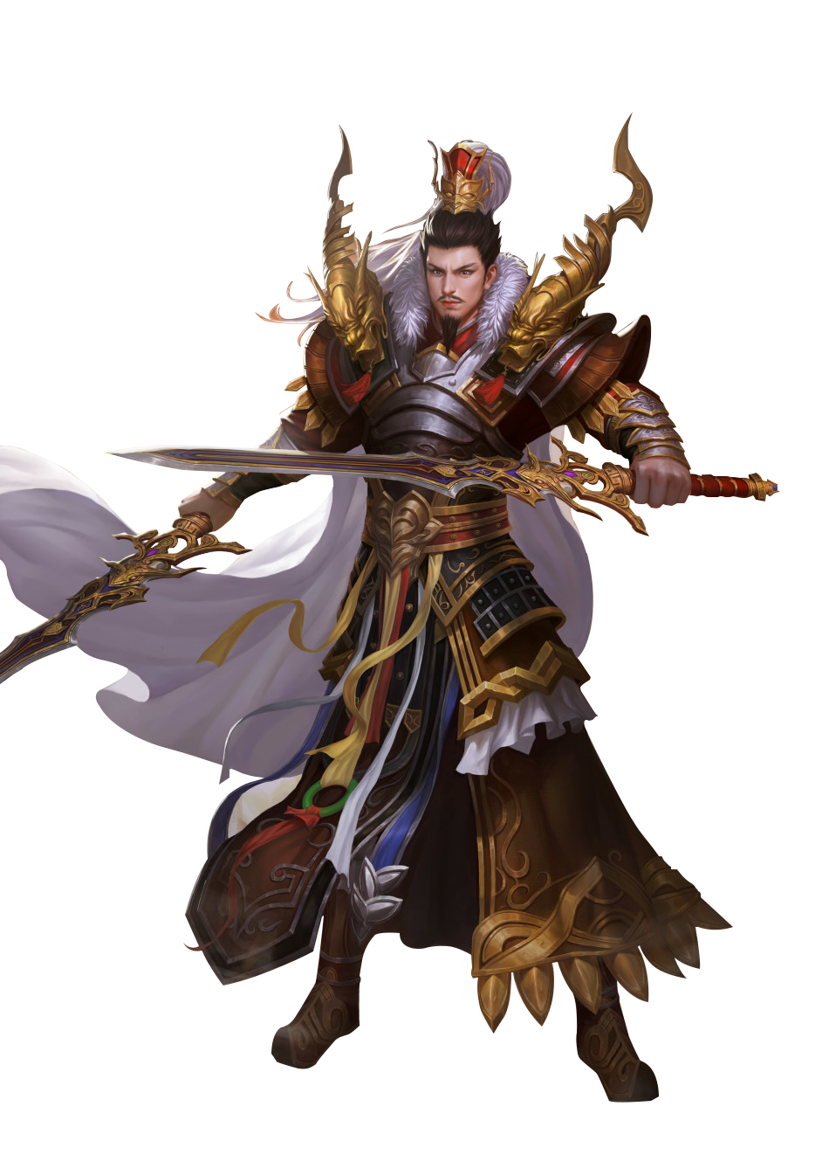
Liu Bei, also known as Xuande, born in Zhuo County of You Province around 161 AD. Although He claimed descent from the royal lineage of Liu Sheng, the Prince of Zhongshan, his life began in humble conditions. However, He believed deeply in the mission of restoring the Han dynasty.
Character Introduction: Liu Bei刘备

Slide 4
His character is most vividly defined by his strong sense of benevolence, loyalty, and righteousness. He always treated those around him with sincerity, respect, and kindness, believing that a leader's true strength lay in winning the hearts of the people.
Character Introduction: Liu Bei刘备

Slide 5
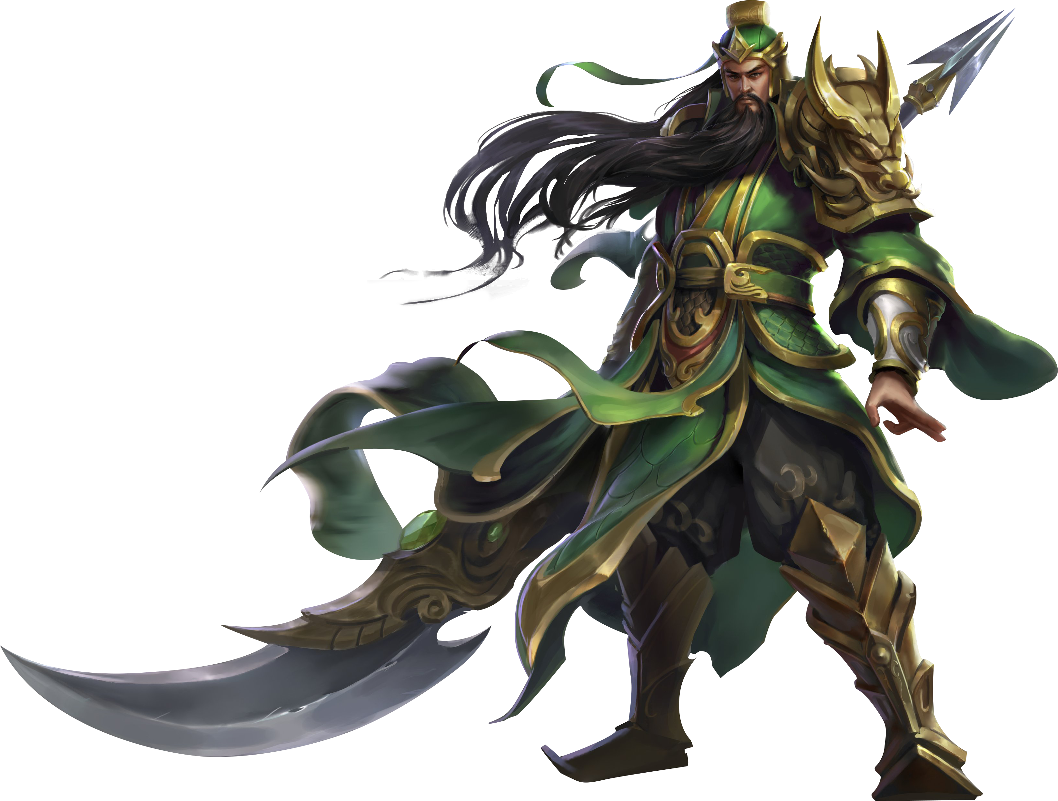
Character Introduction: Guan Yu关羽
Guan Yu, styled Yunchang, was a renowned general of the Shu Han during the Three Kingdoms period. he is celebrated as the foremost among the "Five Tiger Generals"
﻿As a key general of Shu Han, Guan Yu was exceptionally brave. In order to reunite with Liu Bei, Guan Yu cross five passes and slay six generals.After finding out that Sun Wu had set a trap at the banquet, Guan Yu still went to the meeting alone with his sword and came back safely. When Liu Bei advanced into Hanzhong, Guan Yu took advantage and release the Han river’s water, ultimately annihilating Yu Jin's forces of seven armies.

Slide 6
Character Introduction: Guan Yu关羽
Guan Yu was not only exceptionally brave but also known for his loyalty and righteousness. When he was forced to rely on Cao Cao. Upon learning where Liu Bei is, he broke through the dilemma to reunite with Liu Bei.
During the Battle of Red Cliffs, as Cao Cao retreated and was pursued by Shu Han forces, it was Guan Yu who spared Cao Cao in order to repay Cao Cao's life-saving grace with his own life.

Slide 7
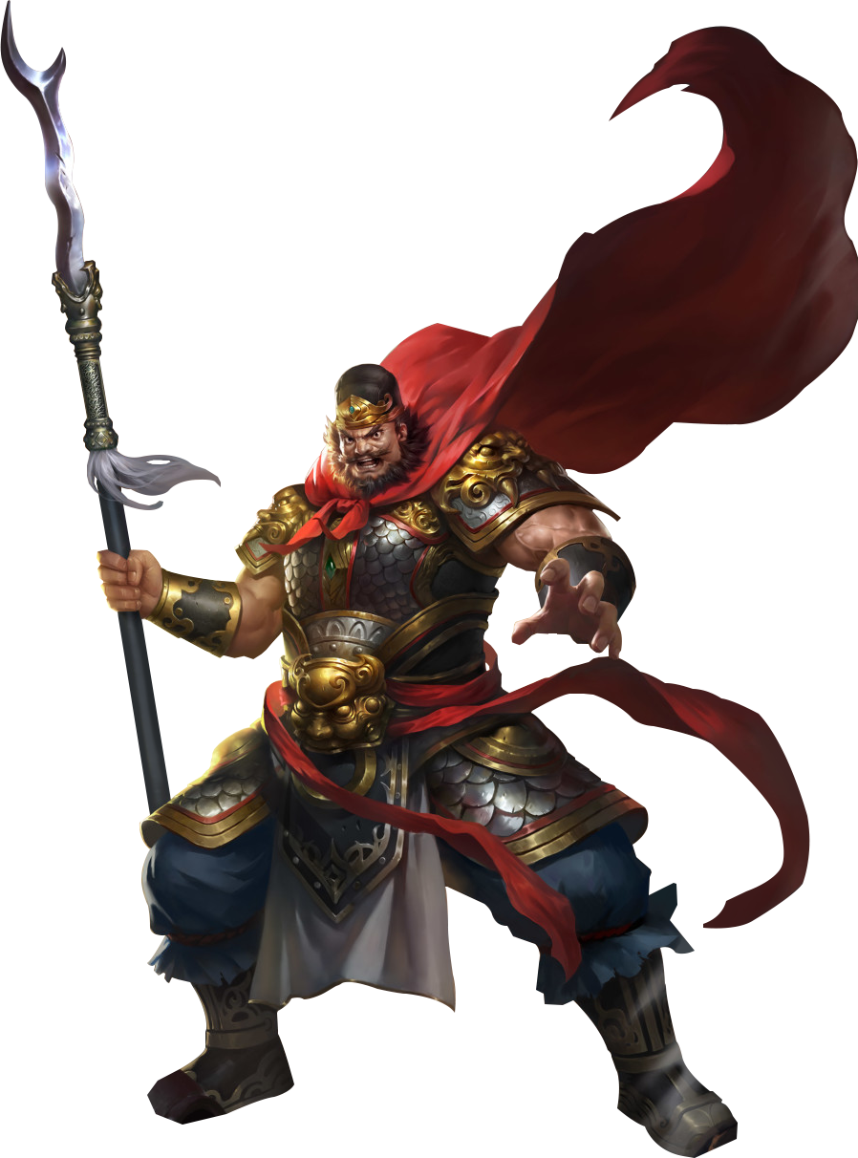
Character Introduction: Zhang Fei张飞
Zhang Fei, a legendary warrior from China's Three Kingdoms period, is celebrated for his formidable combat skills and unwavering loyalty to his brothers, Liu Bei and Guan Yu. Born in 167 AD, he became a key military leader known for his fierce character and exceptional prowess with his spear.
Zhang Fei was characterized by his bravery and impulsiveness.

Slide 8
Character Introduction: Zhang Fei张飞
Zhang Fei played a crucial role in the Battle of Guandu, Defense of Changbanpo and Conquest of Jingzhou fighting bravely alongside his brothers Liu Bei and Guan Yu.
Zhang Fei remains an famous figure in Chinese history, inspiring countless people with stories of bravery and brotherhood.

Slide 9
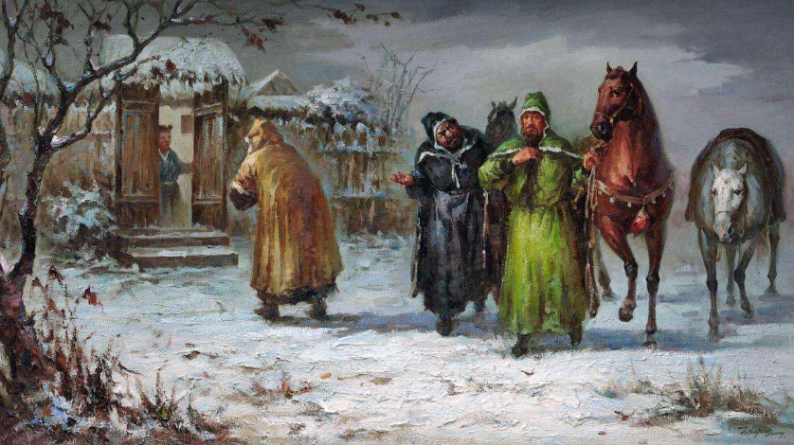
Performance:Visit the cottage three times 三顾茅庐
May Mr. don’t abandon our cheap, help us,Bei ready to listen to the instruction
愿先生不弃弊贱，出山相助，备躬听教诲
For the purpose of the general, Liang is willing to serve the dog and horse
为图将军之志，亮愿效犬马之劳

Slide 10
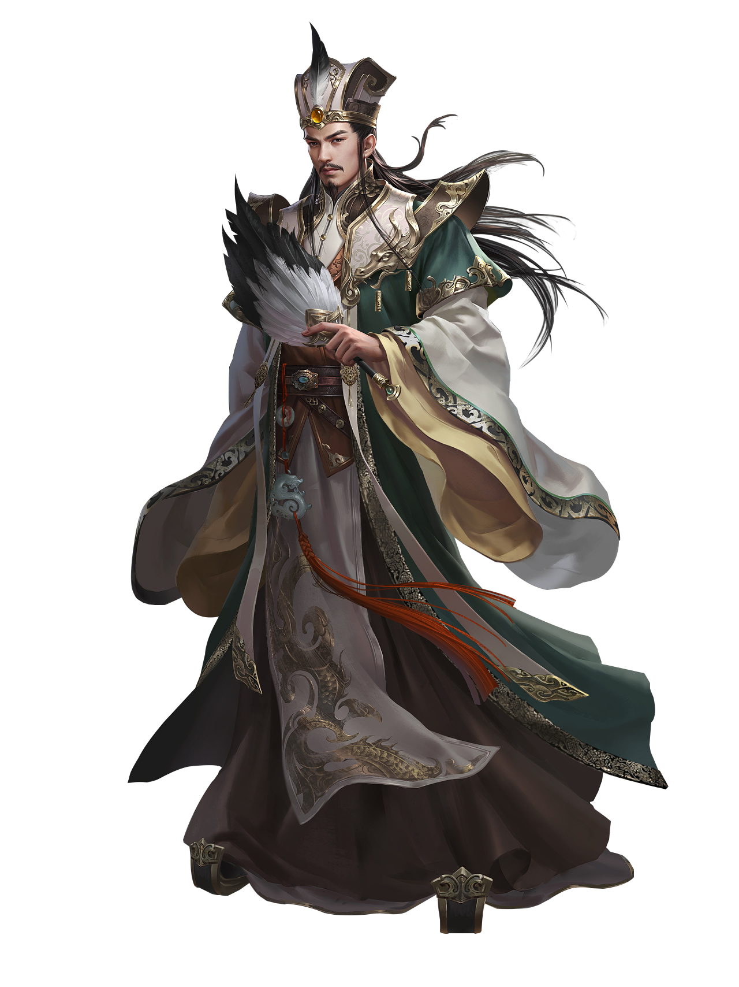
Background: Zhuge Liang , courtesy name Kongming, also known as the “Crouching Dragon,” was a prominent politician, military strategist, and statesman during the late Han Dynasty and Three Kingdoms period. His brilliance and achievements made him a symbol of wisdom and loyalty.
Character Introduction: Zhu Geliang诸葛亮

Slide 11
Character and Qualities Loyalty:
Zhuge Liang remained loyal to Liu Bei and the Shu-Han state throughout his life. He exemplified the phrase “to serve with unwavering dedication, until the very end”. Wisdom:
Known for his exceptional intelligence, Zhuge Liang was highly skilled in strategy and governance.
Diligence and Self-Discipline:
Zhuge Liang lived a frugal life and governed with integrity, always leading by example.

Slide 12
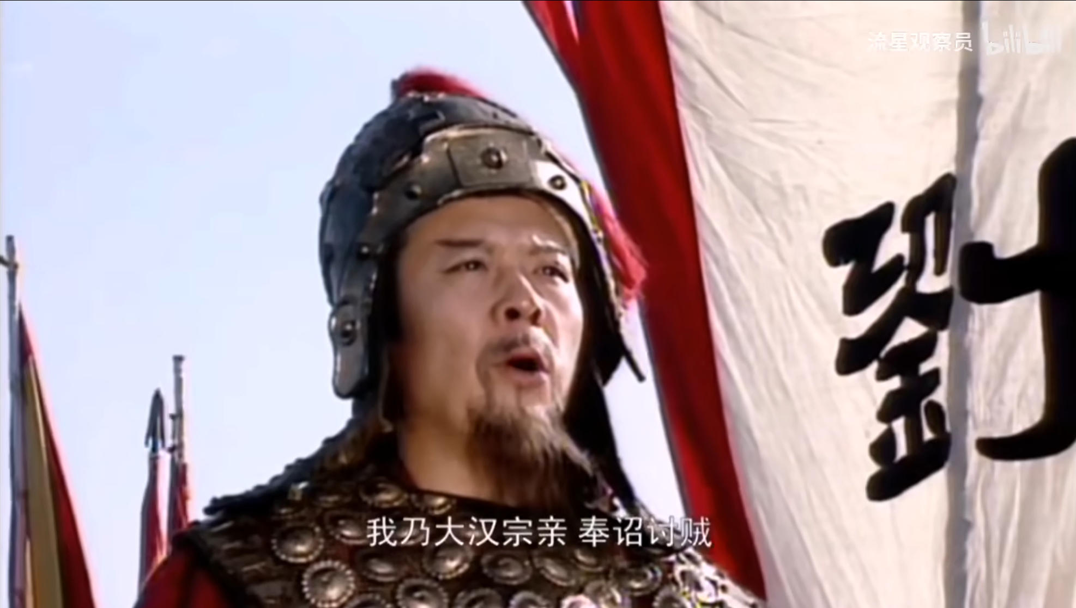
Performance:The Battle of Hanzhong 汉中之战
I am a relative of the Han Dynasty, and I have been ordered to punish thieves
我乃大汉宗亲，奉旨讨贼

Slide 13
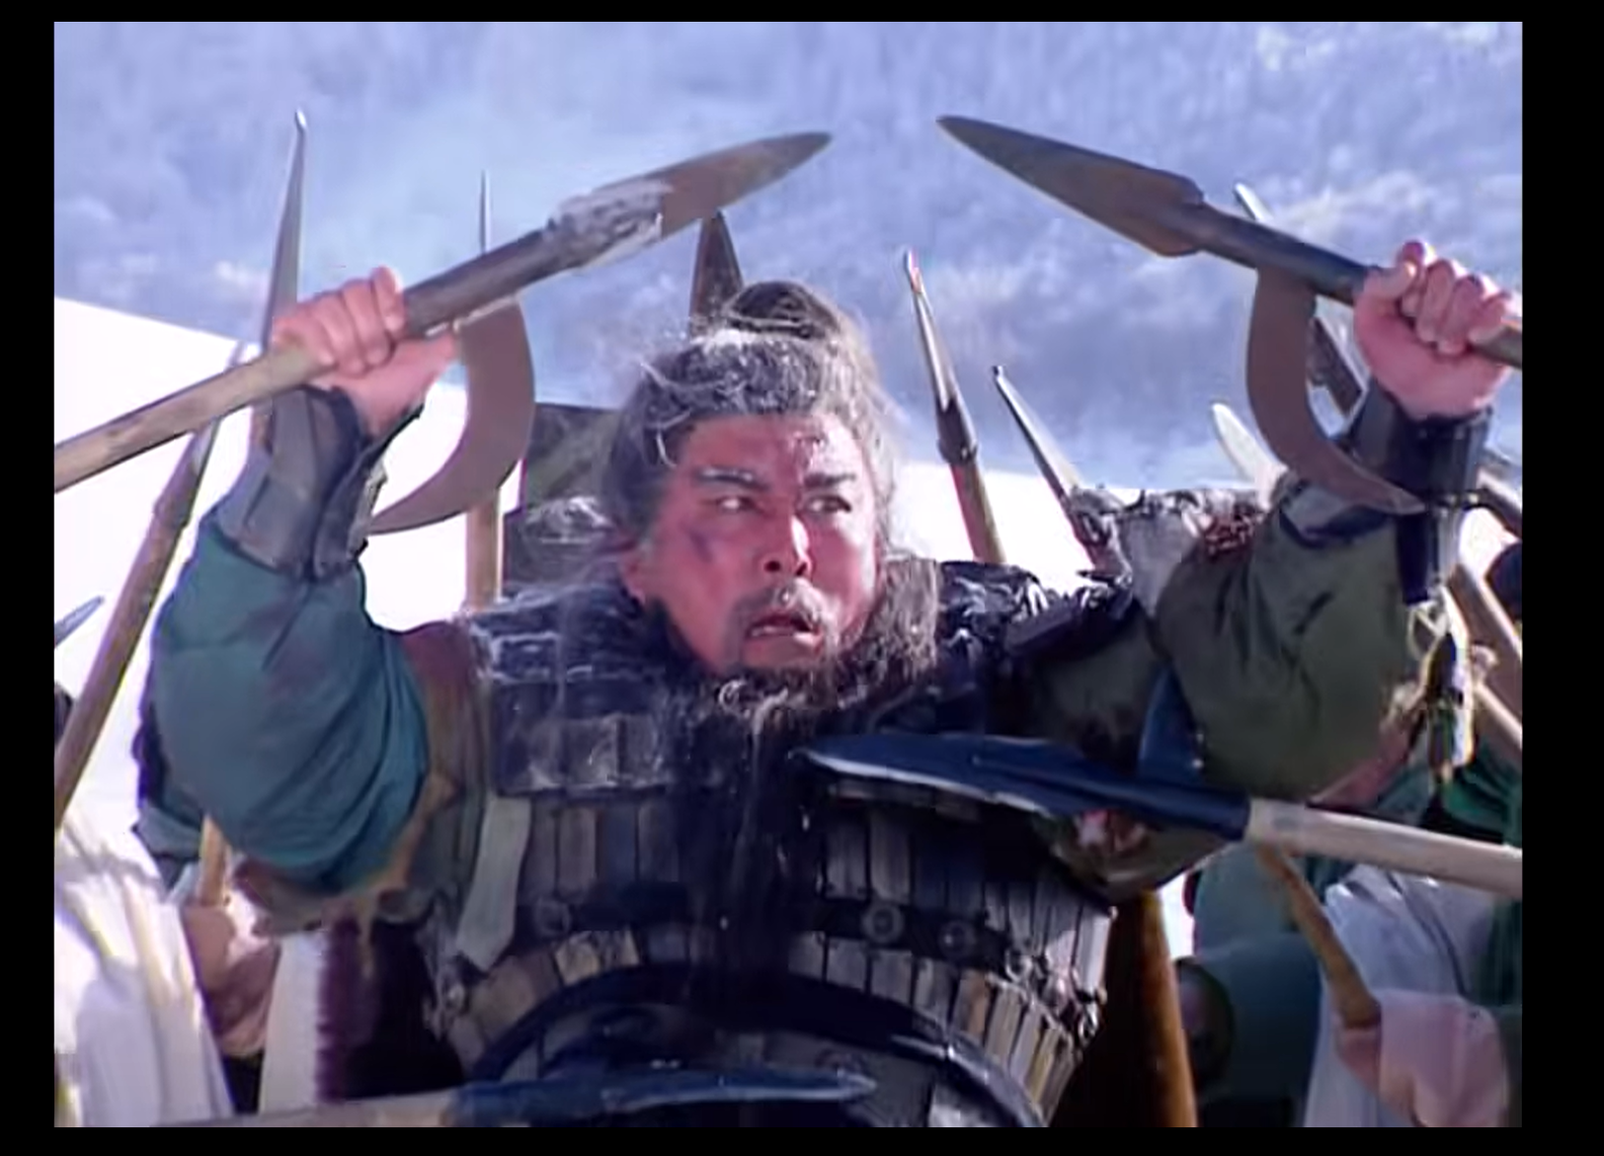

Performance:Lose the wheat city 败走麦城
I feel guilty to my brother for not holding Jingzhou
没有守住荆州，我有愧于兄长
This is Wheat City
啊，这里就是麦城

Slide 14
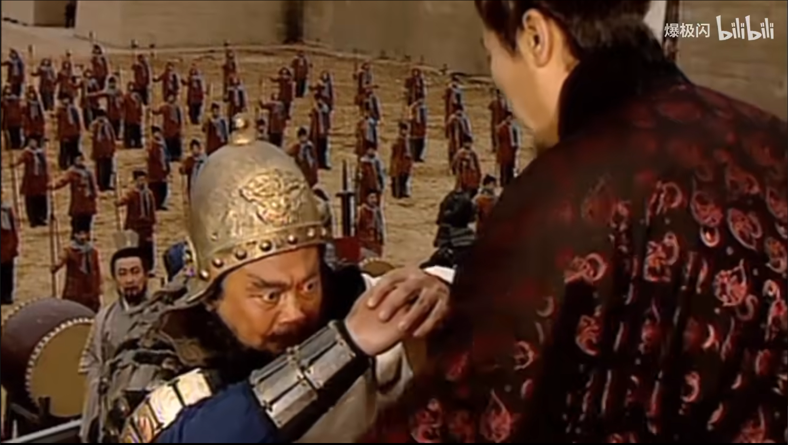
Performance:Send army against Wu 出兵伐吴
If brother refuses to send troops, I will fight to my death, I will avenge my second brother
若陛下不肯发兵，臣拼着一死，也要与二哥报仇
I would prefer to perish rather than witness brother's presence.
此仇不报，臣宁死不见陛下
My brother, I will go with you
三弟，兄与弟同往

Slide 15
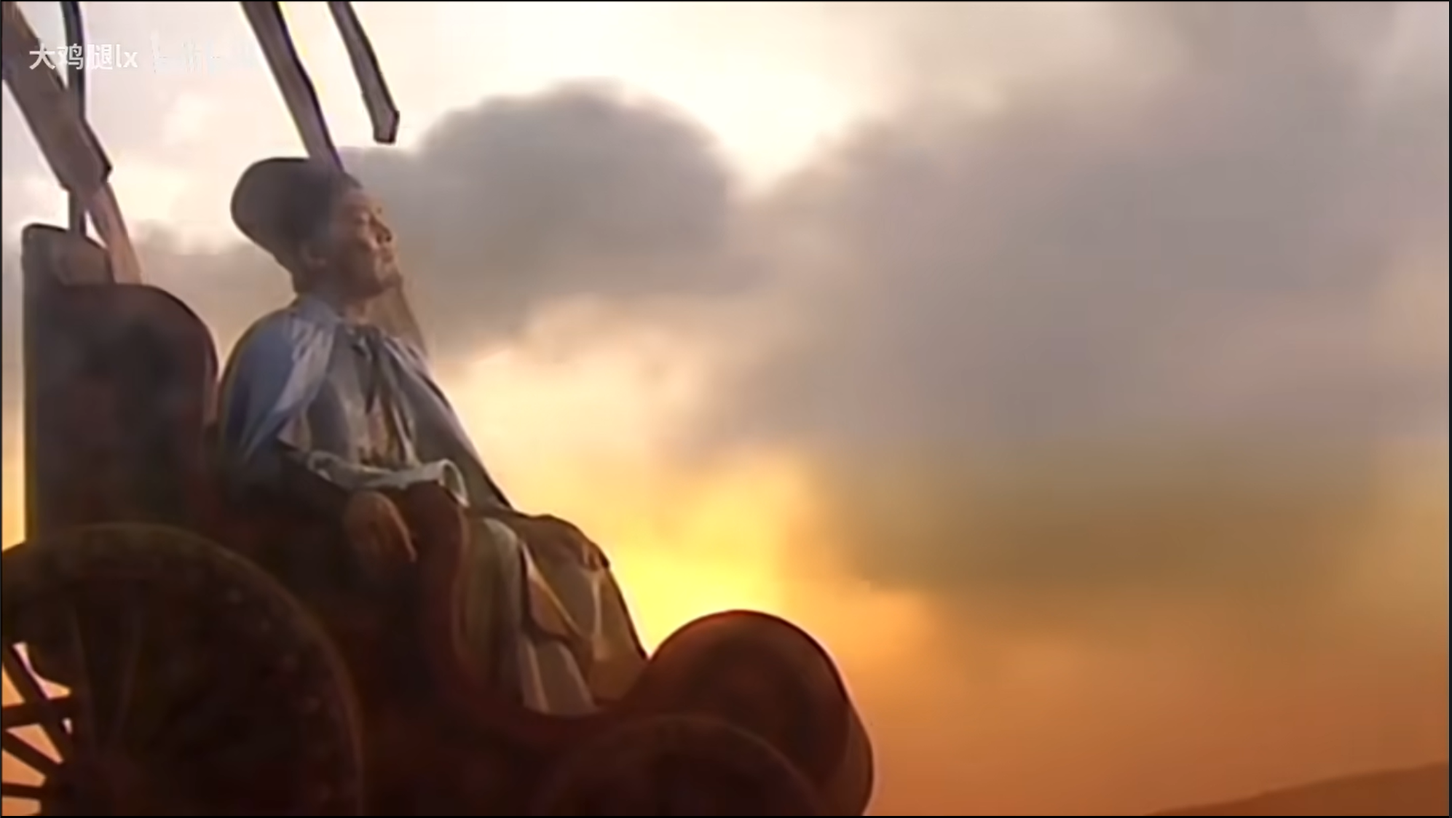
Performance:Autumn wind five zhangyuan秋风五丈原
Liang can no longer beg for thieves, leisurely sky, why thinner than me
亮再不能临阵讨贼，悠悠苍天，何薄于我
Take care, Prime Minister
丞相，保重啊！

Slide 16
Thanks for listening!
group members: 王鸣一，孙溯阳，李璟昊，张喆，张耘丰
reporting time：October 31st

